Slide 1

The future for data analysis in ecology and evolution?
Michael Krabbe Borregaard
Natural History Museum of Denmark

Slide 2
Who am I?
Michael Krabbe Borregaard
Assistant Professor at Center for Macroecology, Evolution and Climate at University of Copenhagen
Working on Island Biogeography and Macroevolutionary patterns
Used Julia since 2015, developer of several Julia packages and owner of two Julia github organizations
Software Notes editor at Ecography

Slide 3
Goal and programme for today
Get you to feel comfortable working in Julia
Convince you that you are not wasting your time
Cover some best practices for scientific computing with Julia

Slide 4
WSIWMTLAPL
Or: "Why should I waste my precious time learning yet another faddish programming language??"

Slide 5
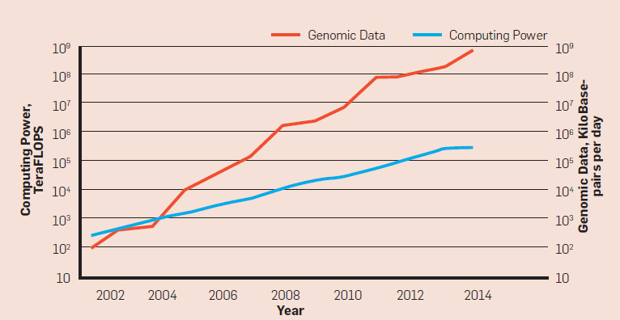

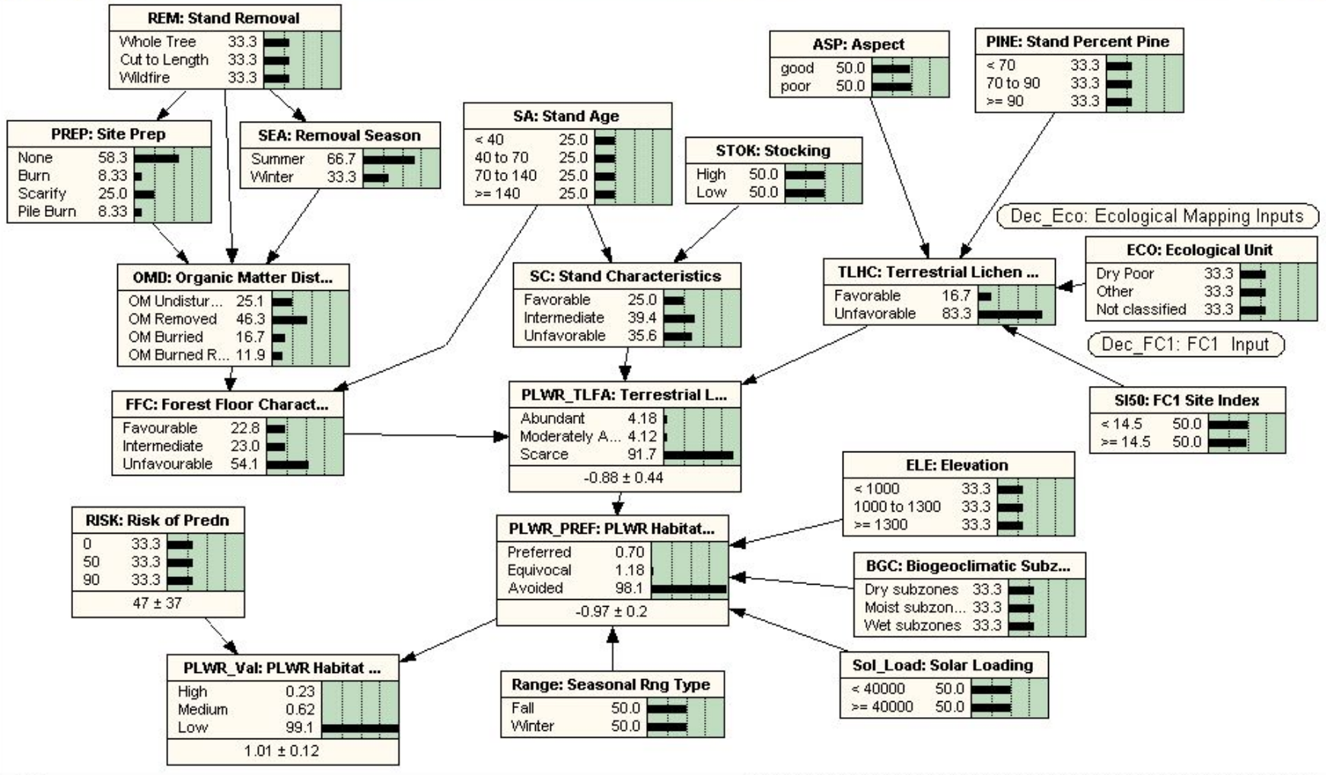
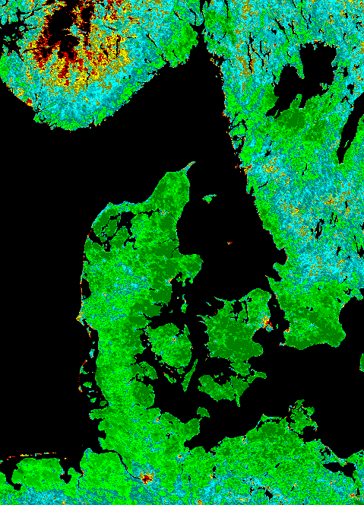
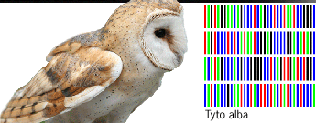
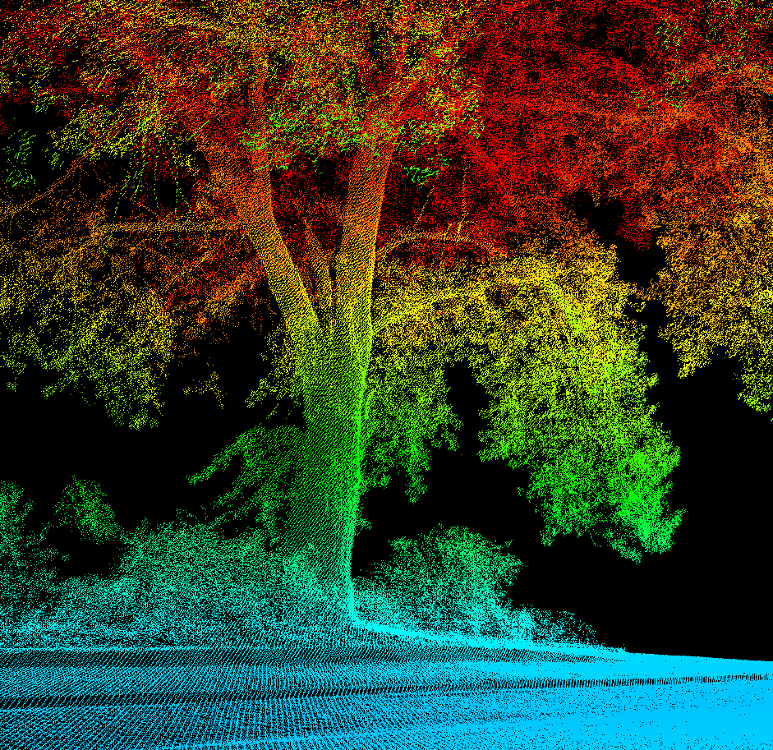
Berger et al. 2016, doi 10.1145/2957324

Slide 6
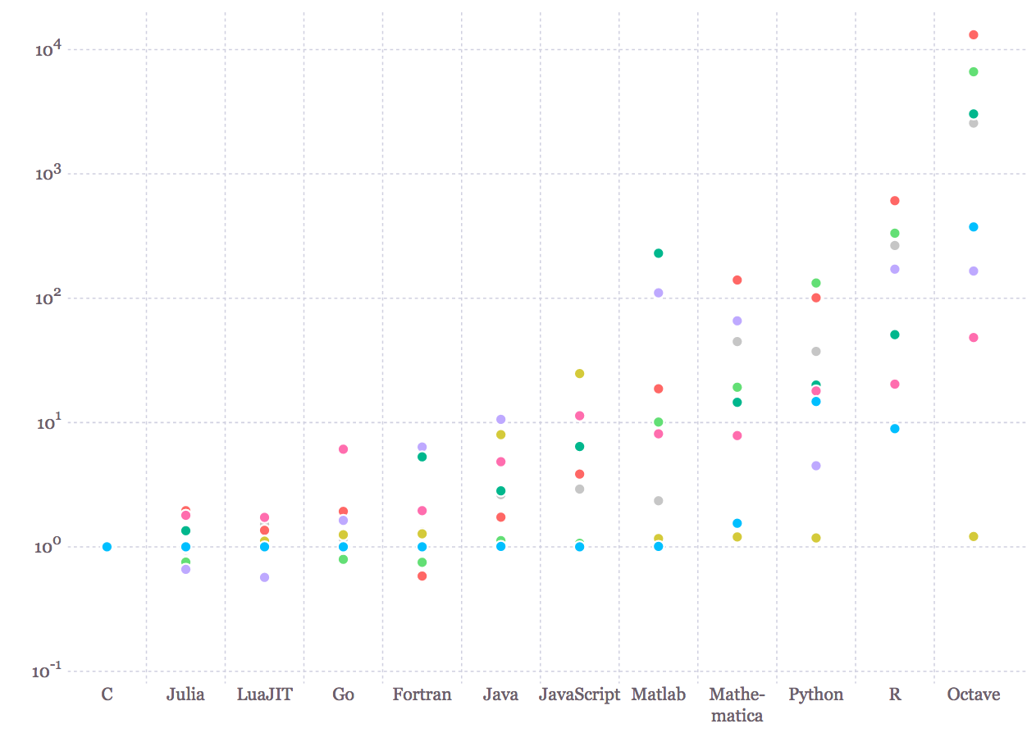

1000x
100x
10x
1x

Slide 7
Is speed really that important?
Speed has a special status
A solution to the 2-language-problem
Does a package/library do exactly what you need?
Yes: Great!
Dunno: You need to read C/++ code.
No: You need to code in C/++.
Much easier to be a package author
Transparency and scientific reproducibility

Slide 8
Why is julia fast? (how do computers work 1)
And why can it feel slow?
Julia and R are essentially different, one is compiled, the other interpreted
Compiled
C, C++, Fortran, Java, Julia
Interpreted
R, Python, Matlab
But Julia is still fast, thanks to JIT and LLVM

Slide 9
Tooling
There are three main ways of interacting with Julia:
REPL (much nicer than R’s)
Juno (RStudio-like IDE)
Jupyter notebooks (also work with R)

Slide 10
Get up and move your arms and legs a little
Find a partner (or two) for today’s work
Preferably with someone at a very different level of experience than yourself

Slide 11
Types (how do computers work part 2)
How are things stored in a computer’s memory

Slide 12
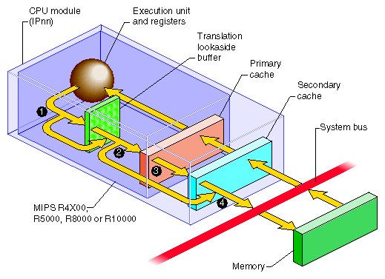
What does a computer spend time on (how do computers work 3)
Memory accesses
and computation

Slide 13
Julia is developing
But code is formally deprecated
And the Environment system helps a lot

Slide 14
Getting help
It is less easy to find answers to everything by googling!
There is LOTS of help, and a very friendly community. The main sources are
The official manual is easy to read: – https://docs.julialang.org/en
StackOverflow – tag ‘julialang’
very useful for searching existing answers, but many answers get outdated. answers within 1 hour usually
Discourse – discourse.julialang.org
good for longer discussions, answers within hours
Slack – slackinvite.julialang.org
real-time responses, tend to attract more advanced users. Instantaneous answers but people will expect you to RTFM

Slide 15
Exercise
Talk together for a few minutes, and identify the 5 functions from R you’d most like to know what is called in Julia
Answer on Socrative – room MACROECOLOGY

Slide 16
Pkg – julia’s package manager
Starting up new projects
Environments make for reproducibilty
instantiate new environments etc

Slide 17
Starting a new project
]add PkgDev#kc/07 (only once)
navigate to where you want your package to live
using PkgDev; PkgDev.generate("PackageName", "MIT") or whatever license you prefer.
]dev /path/to/PackageName
]activate /path/to/PackageName
Then you can from now on simply using PackageName to use it, and add any packages you depend on

Slide 18
Julia’s package ecosystem
Based on GitHUB
Very focused on modularity, reusability and interfaces
Collaboration between developers
Open source, MIT licence, much collaboration

Slide 19
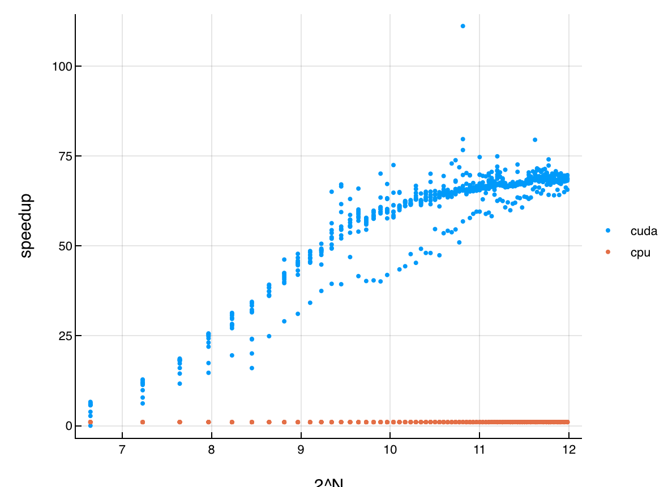
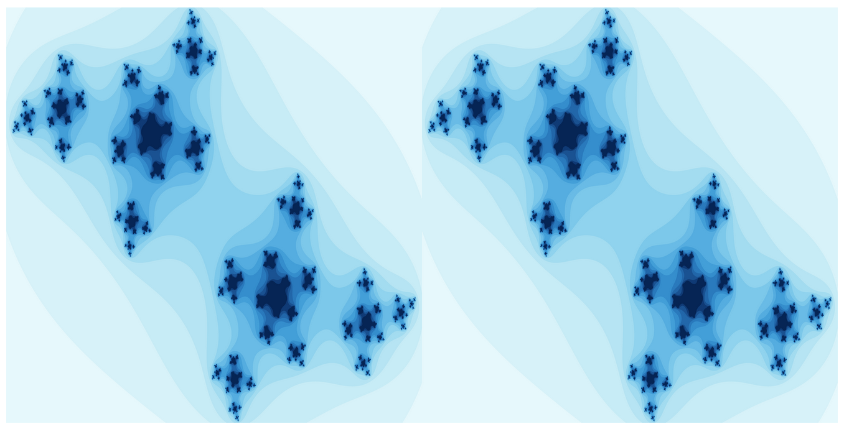
Parallel programming with Julia
Julia is built for advanced parallelism
Easy support for basic parallelism with eg pmap
But can also do much more advanced things, e.g. different processes that do different parts of the program and wait for each other (possibly mostly useful in packages)
Julia makes it easy to code on the GPU!

Slide 20
Plotting
Julia has no ”base plotting” – all is provided by packages. These include
Plots – meta-syntax for several plotting packages and julia structs
PyPlot – Python’s wildly popular matplotlib used directly within Julia
Gadfly – a pure-julia implementation of Grammar of Graphics (GOG)
PlotlyJS – an offline interface to the javascript plotly library
GR – a really fast low-level plotting platform
PGFPlots(X) – plotting in LaTeX (for engineers)
VegaLite - a modern javascript implementation of GOG (ggplot2-style)
Makie – powerful plotting on the GPU with good 3D and interactivity
Bokeh, Winston, Vega, etc.

Slide 21
Plotting
Julia has no ”base plotting” – all is provided by packages. These include
Plots – meta-syntax for several plotting packages and julia structs
PyPlot – Python’s wildly popular matplotlib used directly within Julia
Gadfly – a pure-julia implementation of Grammar of Graphics (GOG)
PlotlyJS – an offline interface to the javascript plotly library
GR – a really fast low-level plotting platform
PGFPlots(X) – plotting in LaTeX (for engineers)
VegaLite - a modern javascript implementation of GOG (ggplot2-style)
Makie – powerful plotting on the GPU with good 3D and interactivity
Bokeh, Winston, Vega, etc.

Slide 22
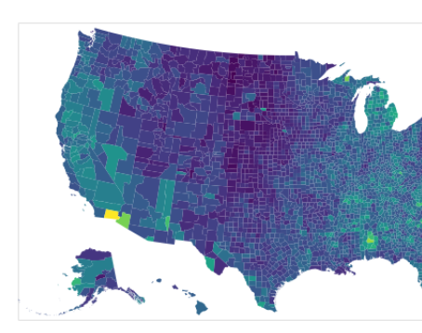
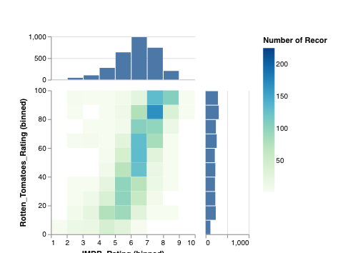
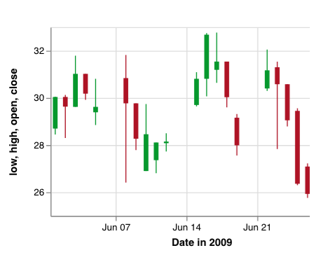
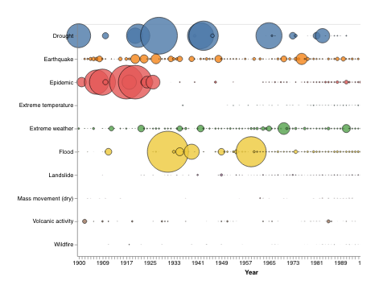
VegaLite
Very ambitious modern implementation of the grammar of graphics*
built by a large group at ... university
*grammar of graphics:
data are in dataframes
plot calls are declarative – you don’t draw, but associate data with aesthetics

Slide 23
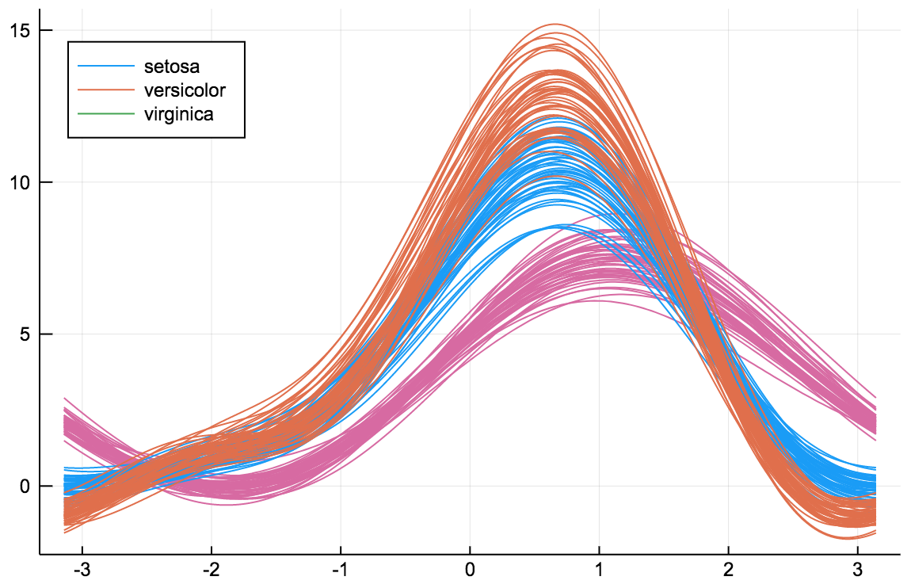
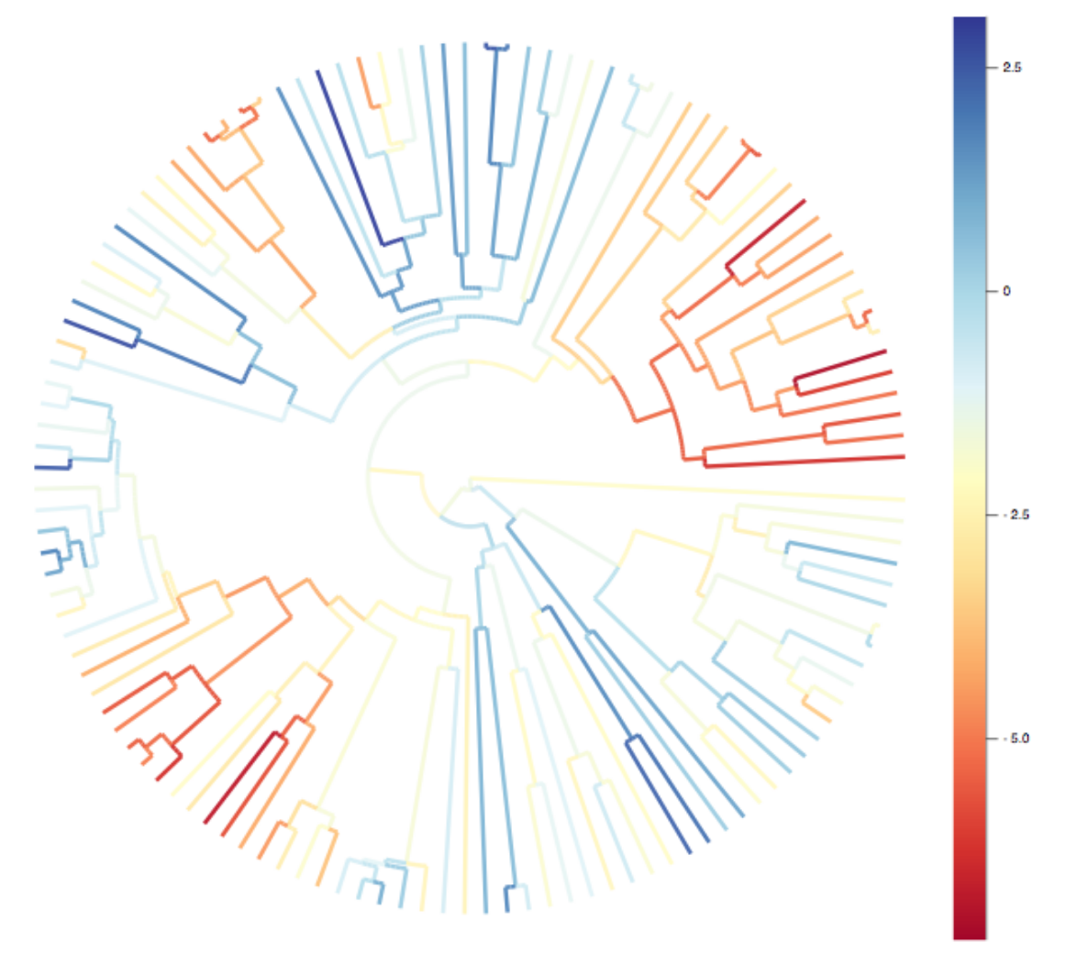
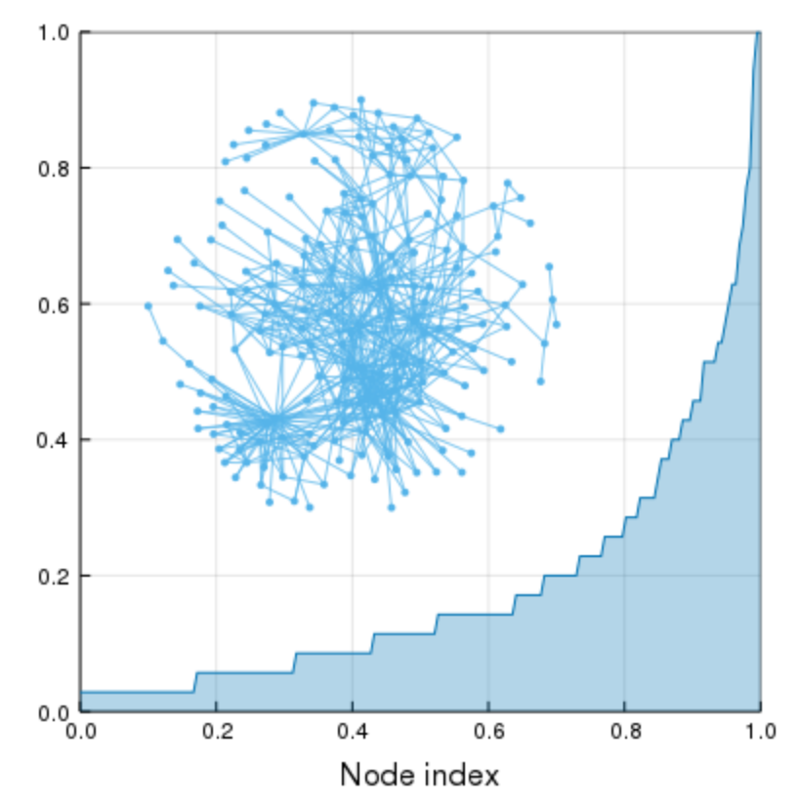
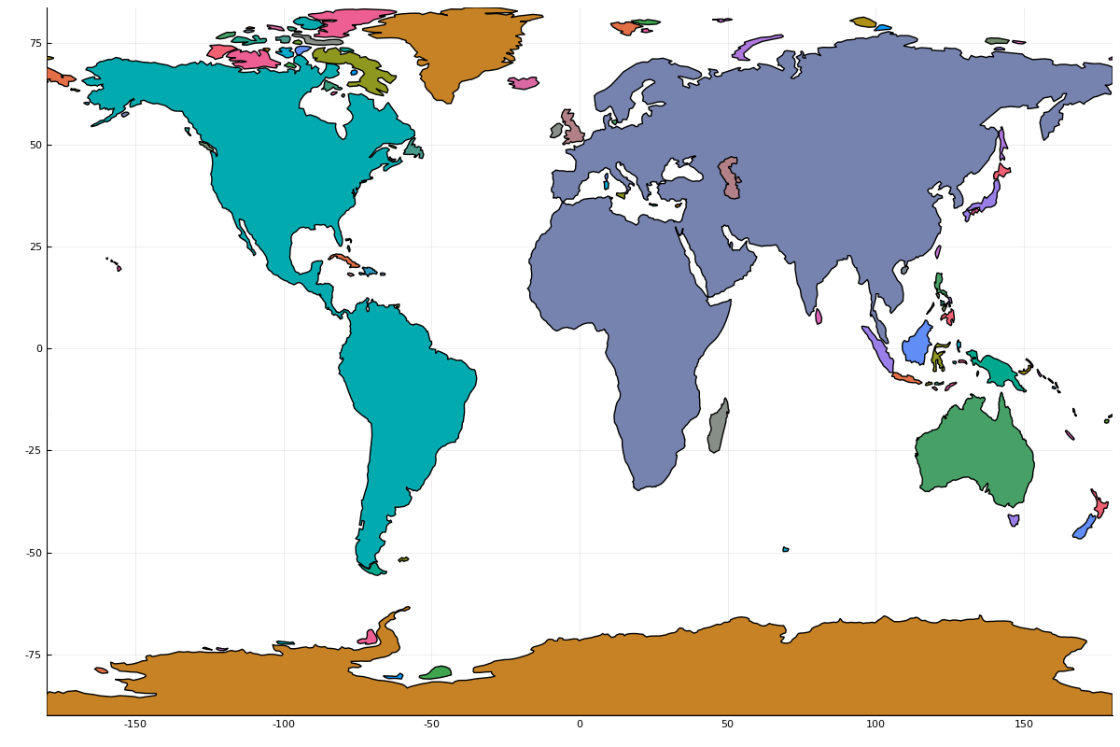
Plots
A package that creates a single syntax that can be used to plot with PyPlot, GR, PlotlyJS, PGFPlots, InspectDR
The most notable thing is ”recipes” that allow package authors to define plotting for their structs without depending on Plots
Used by SpatialEcology, Phylo, EcologicalNetworksPlots, MicroBiome, the Geo organisation, Turing (Bayesian analysis), DifferentialEquations

Slide 24
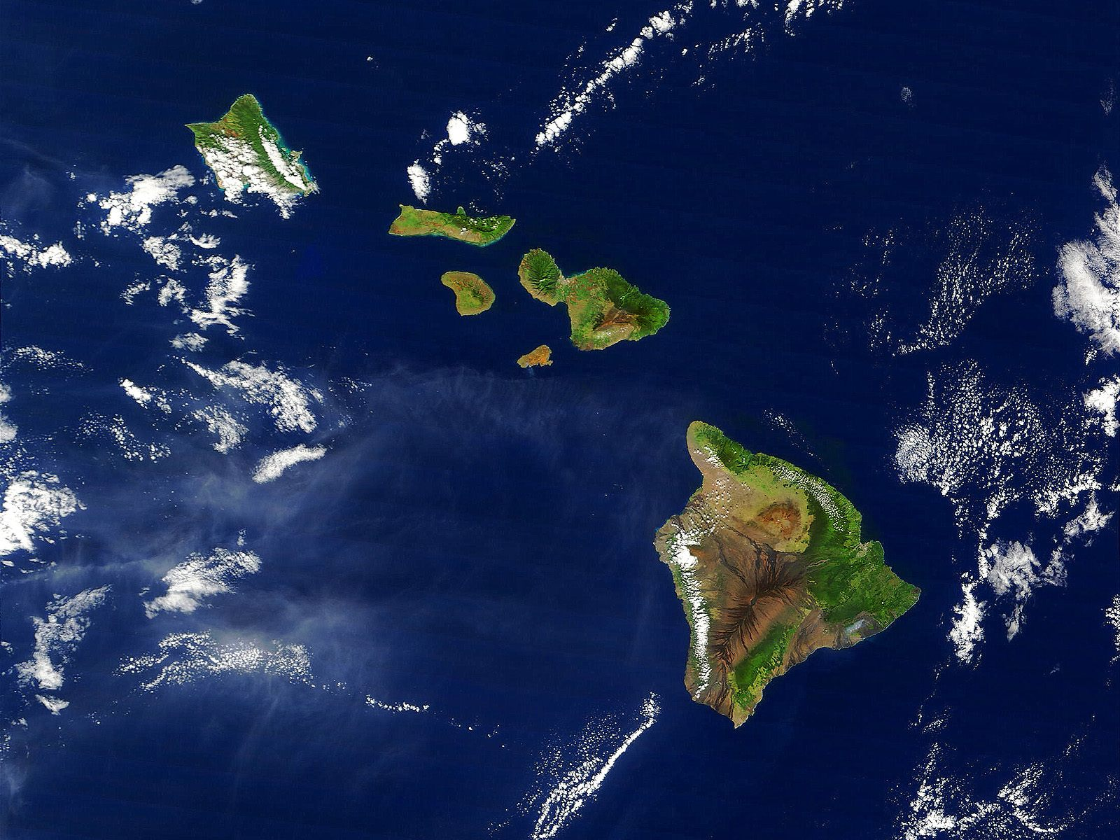
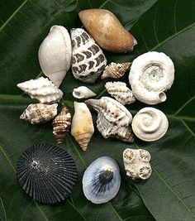
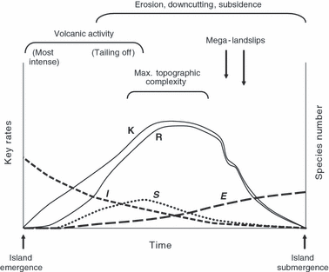


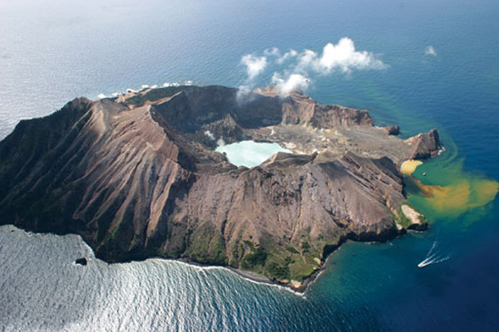

Linear and Mixed Models
Let’s investigate the global island occurrences of snails in the context of the General Dynamic Model of Island Biogeography

Slide 25





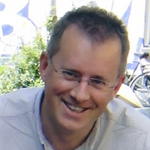




Timothée Poisot
University Montreal
Richard Reeve
University of Glasgow
Kevin Bonham
Harvard University

Slide 26
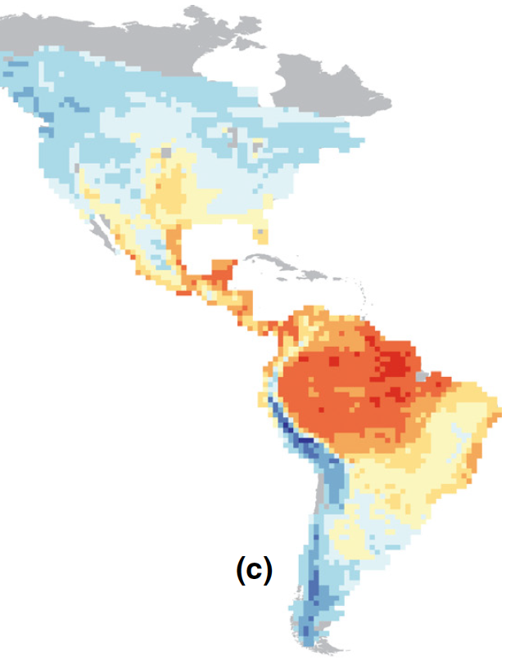
Basic data format for the other packages
Combines
Species occurrences
Spatial locations
Traits
Environmental data
Phylogenies
Interaction networks
Uses a split–apply–combine strategy to make macroecological analysis easy

Slide 27
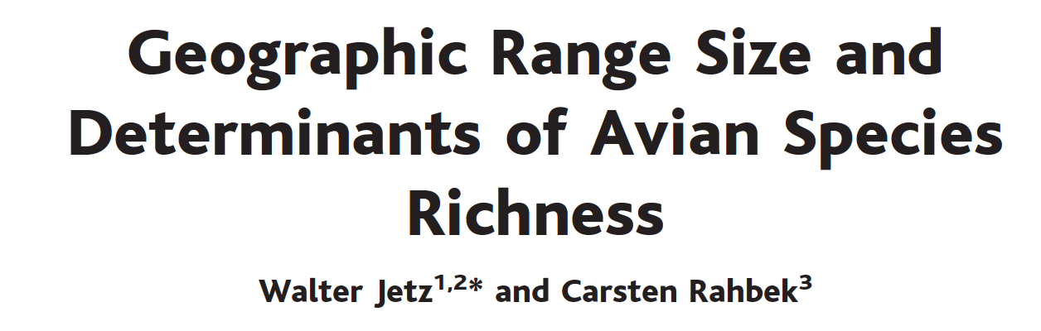
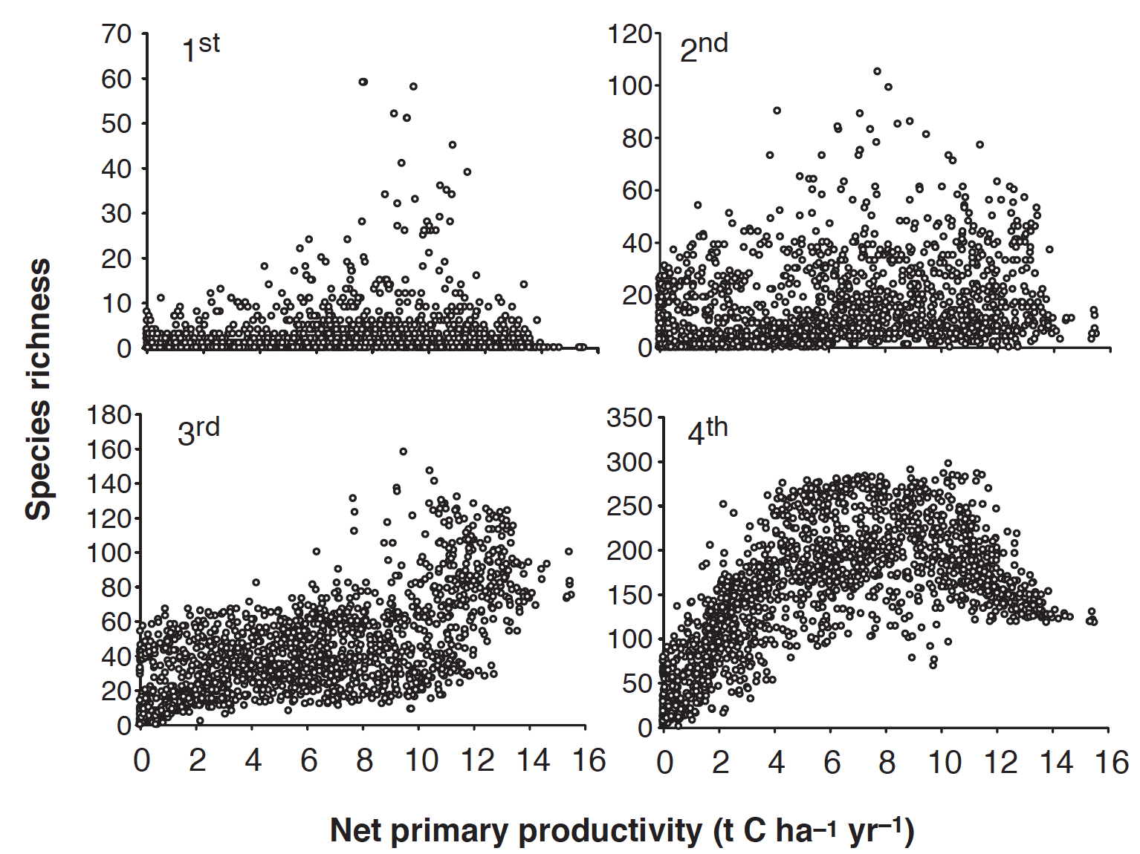
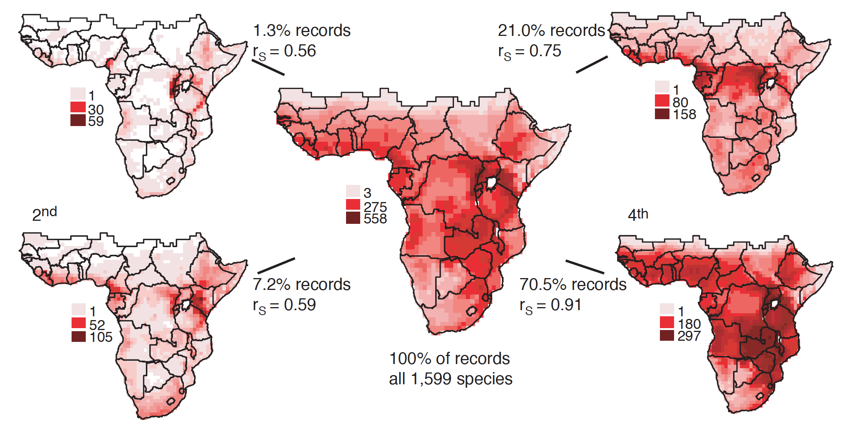

Slide 28
GBIF
An interface to the GBIF library

Slide 29
The JuliaGeo organisation
ShapeFile
Proj4
GDAL
ArchGDAL

Slide 30
Diversity
Very advanced library for analysis of diversity metrics based on Hill numbers
Has sublibraries for other types of diversity analysis as well
Ecology, Jost, etc

Slide 31
Phylo
Julia-style library for dealing with Phylogenetic trees
Very different from ape!

Slide 32
RandomBooleanMatrices
Library for matrix / community randomizations
Legacy matrix randomizations slow and inaccurate
Currently implements ”curveball” (Strona et al 2014) but more advanced algorithms are in process
Including algorithms optimised for the GPU

Slide 33
EcologicalNetworks
And EcologicalNetworksPlots

Slide 34
Other cool frameworks we haven’t had time to cover

Slide 35
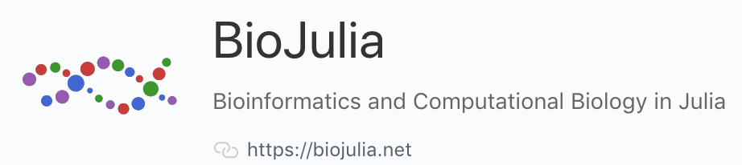
Framework for molecular biology analysis in Julia
https://biojulia.net

Slide 36
Turing
turing.ml
Probabilistic programming language
Advanced Bayesian analysis in Julia

Slide 37
Flux
Julia’s answer to Machine Learning

Slide 38
DifferentialEquations
Probably the most flexible and advanced software for this around

Slide 39
JUMP
Mathematical Optimisation

